Slide 1
StartInvest
A “Klaus Klaus Klaus”-Solution to Financial Illiteracy

Slide 2


The Team Who are we?
David Mellert
Kilian Krüger
Yingliu Lu
Andreas Pletschko
2

Slide 3



The current situation How inaccessible is financial data?
High quantity of information
Abstractness of financial metrics
Large amount of financial products
SIX
3

Slide 4
Our solution A beginner-friendy trading platform
Users begin with an initial level with only limited and most important information and financial products
After a certain trade volume, users level-up and unlock new financial informations and products
Every financial product can only be used with virtual money in the beginning
Users don‘t get overwhelmed with to much features
User can get used to every information
User is not involved in risky investments without the needed experience

Slide 5
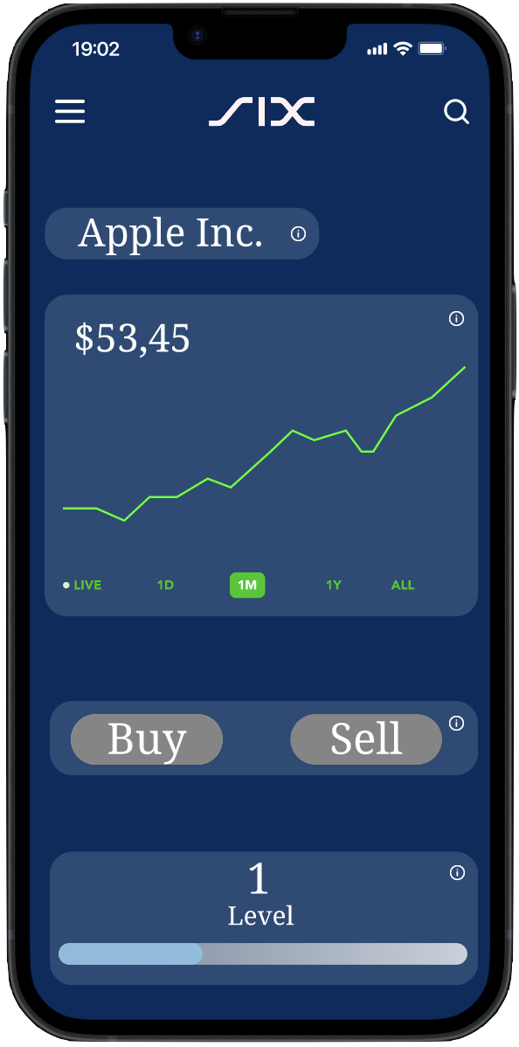
Design mock-up

Slide 6
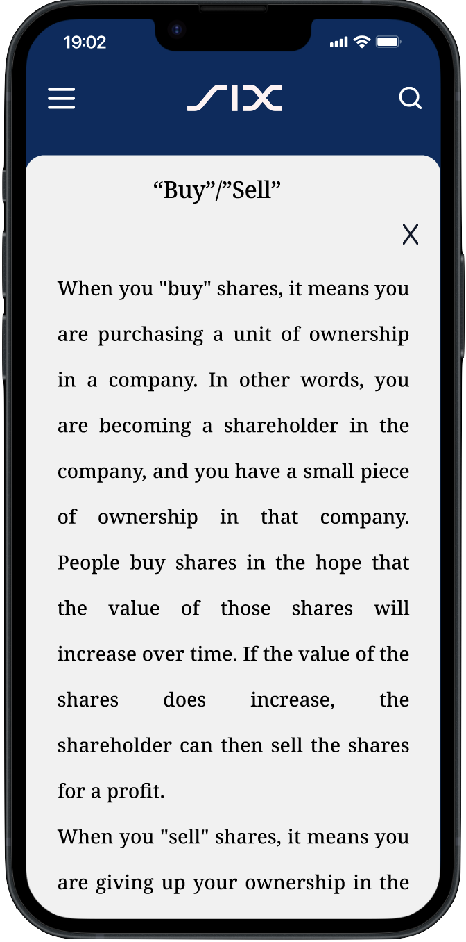
Design mock-up

Slide 7
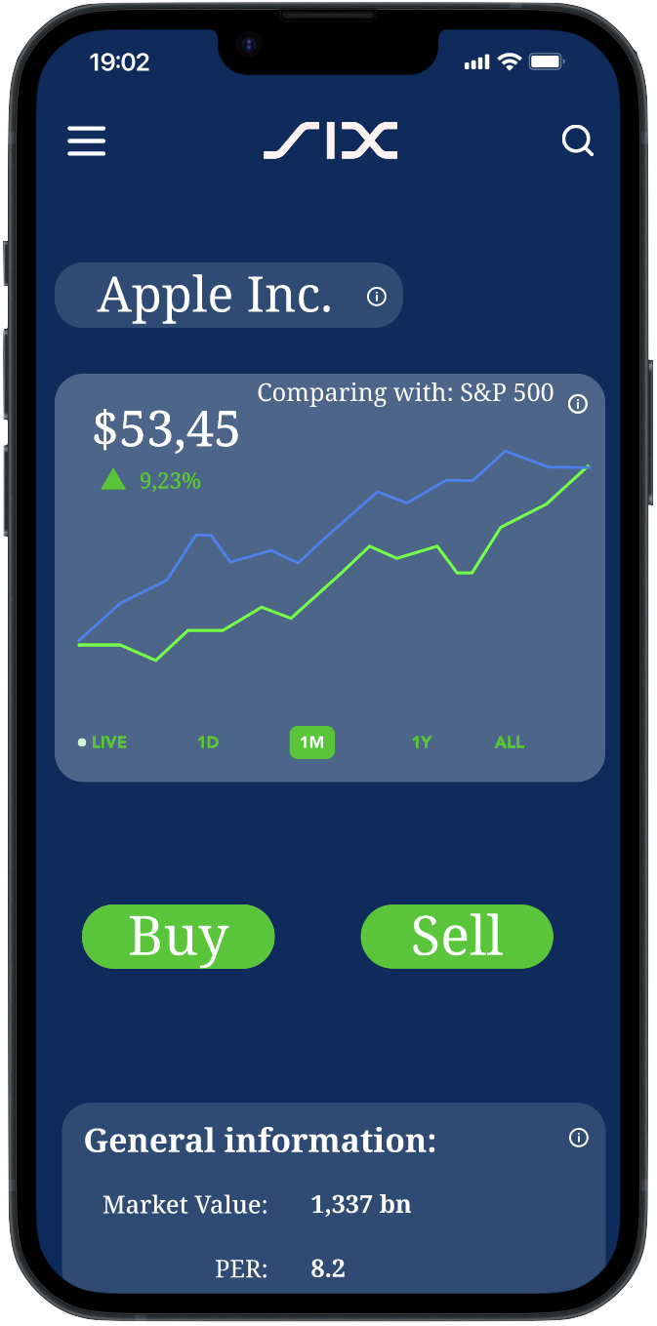
Design mock-up

